Slide 1
SteganAnalysis
Instructor:
Behnoud shafizadeh

Slide 2

Steganography and Steganalysis ecosystem
In summary:
Steganogeraphy : process for hiding data in different context(image,audio,…)
In contrast,
Steg Analysis : process for extracting data in different context(image,audio,…)

Slide 3
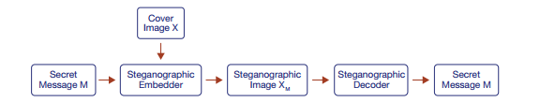
Steganography Ecosystem
Steganogeraphy :
Embedding
Transmission
Decoding

Slide 4
Purpose and various groups
In steganography, the steganographic embedder aims to minimize the difference between X and XM.
Steganographic embedders can be categorized as one of three types:
frequency
spatial
deep learning

Slide 5
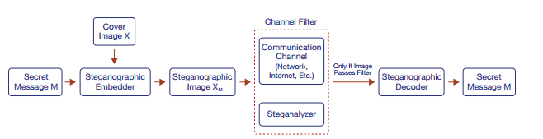
Steganalysis Ecosystem
Steganalysis is the process of detecting if a file contains steganographic content. steganalyzers could be used in real-world scenarios to block the transmission of steganographic content.
Steganalyser divided in two groups:
statistical techniques
deep learning methods
Deep learning models have a better performance rather than statistical models

Slide 6
Different types of steganalysis
There are two types:
Discriminate
only detect a subset of steganographic embedders.
Universal
detecting all known and unknown steganographic embedders
HINT:our purpose is developing Universl type,for having better performance

Slide 7
Problem Definition and Challenges
Critical problems in constructing ,practical and universal deep learning steganalysis:
Training and Execution Efficiency Problem : Most steganalyzers are computationally expensive to train and execute .Practical steganalyzers should be computationally efficient so they can be effectively deployed in applications.
Image Size Mismatch Problem Detection - Most steganalyzers can only detect images of a certain size. Furthermore, even those that can detect images of varying sizes tend to be less accurate .Practical steganalyzers must be effective at detecting images of all sizes.
Source Mismatch Problem - Steganalyzers commonly fail to detect steganographic images generated from a dataset the model has not been trained on . Steganalyzers should be able to detect steganographic images regardless of the source dataset.
Steganographic Embedder Mismatch Problem - Most steganalyzers are discriminate steganalyzers and can only detect steganographic embedders they are trained on . Steganalyzers must be able to detect unseen steganographic embedders to effectively mitigate steganography-enabled threat models.
Low Embedding Ratio Problem - Steganographic content is difficult to detect at low embedding ratios, making universal steganalysis increasingly challenging . To neutralize steganography-enabled threat models, steganalyzers must be able to detect low embedding ratios effectively.
Practical and Robust Evaluation Problem - Current research only evaluates steganalysis in a limited context (i.e. steganalyzers are only tested on certain image datasets .Steganalyzers must be evaluated in a diverse context to ensure that they are robust and effective in real-world situations.

Slide 8
Contributions
Practical Steganalysis Architectures - We design architecture, which enable image size mismatch problem detection and training and execution efficiency, respectively.
Robust Training Methodologies - We propose robust training methods that help create more universal steganalyzers. These methods include data augmentation techniques that also help overcome our novel adversarial attack system, StegAttack.
Robust Steganalysis Evaluation System - We develop a Python library, that enables comprehensive evaluation of steganalysis.
Comprehensive Evaluation of Deep Learning Steganalyzers - We comprehensively evaluate state-of-the-art deep learning steganalyzers to discover common failure modes and identify effective techniques.

Slide 9
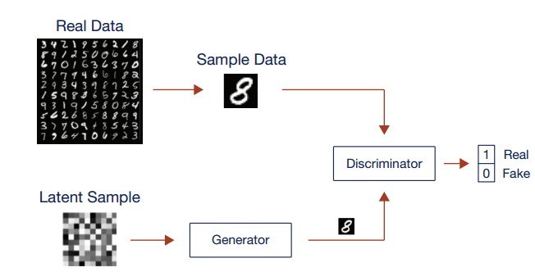
Back ground and related works
Deep learning overview:
deep learning is defined as a class of machine learning algorithms that use multi-layered neural networks to extract higher-level features from raw data . These methods use large amounts of training data to extract complicated, featurerich data for either generative or classification tasks .
Generative Adversarial Network
Divided by two components:
Generator
discriminator

Slide 10
About gan models
Generative adversarial networks (GANs) are deep learning architectures that are composed of a generator and a discriminator. The generator learns how to transform random noise into a target distribution, while the discriminator attempts to identify if the generated images are fake or real. This adversarial setup allows the generator to effectively model target distributions.
Notice: GAN systems are increasingly used in steganography since they are excellent at generating hard-to-detect steganographic images

Slide 11
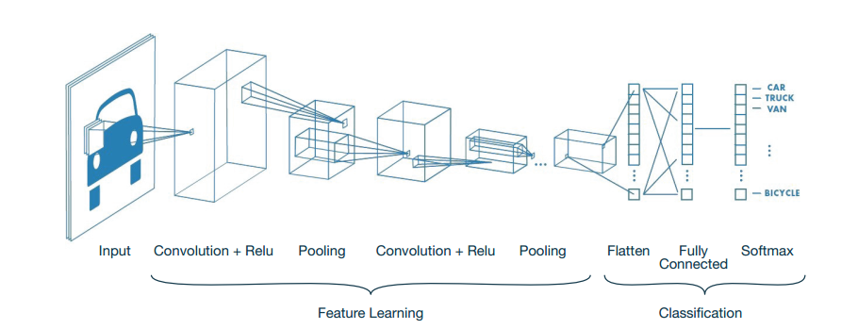
Classification models(Convolutional Neural Network )
Convolutional neural networks (CNNs) are deep learning architectures that use convolutional layers and sub-sampling layers to extract and classify meaningful signals from image data.
Hint: CNNs are used extensively in steganalysis for their ability to learn important features relevant to detecting steganographic images

Slide 12
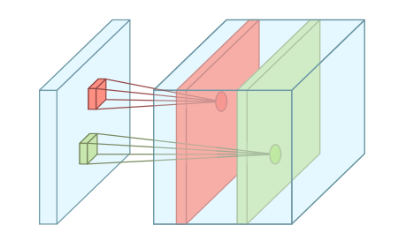
Components of CNN
Convolution layer
Convolutional layers extract spatially relevant data by convolving weights with input data. Convolutions are defined by their kernel size, stride, and padding. These parameters affect the types of spatial features the convolution can extract.

Slide 13
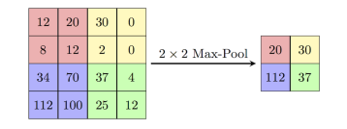
Components of CNN
Polling layer
Pooling layers down-sample input data by applying a function on subregions. For example, max pooling applies a max function to extract the strongest sub-region signals. Pooling is effective at reducing noise and extracting larger features.

Slide 14

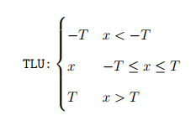
Components of CNN
Activation unit
The activation unit aids in the non-linear decision making of the system by allowing certain inputs to be sent forward.
Even though ReLU is a popular choice for image classification, we also experiment with the truncated linear unit (TLU) , TLU’s are much more effective at boosting weak signals, and thus well suited for a weak signal-to-noise ratio environment like steganalysis

Slide 15

Model Evaluation (the evaluation of deep learning models )
Data:
Since a deep learning model’s success is directly related to the composition of the data on which they are trained and tested, it is crucial that models are evaluated in the context of their training/test data. it is important to compare different models across the same training/test data to enable a fair comparison.
Furthermore, careful consideration should be taken to create a diverse test set so that confounding variables such as source distribution do not affect model performance. models should always be evaluated in the context of the data that they were trained and tested on.
Metrics:
to measure steganalyzer performance, we report the blind detection error at an unoptimized threshold of 0.5. To calculate this error, we first classify all the results using the threshold and then use the following equation:

Slide 16
Model Evaluation (the evaluation of deep learning models )
FP is the number of false positives
FN is the number of false negatives
TP is the number of true positives
TN is the number of true negatives
Hint:The detection error represents the percentage of incorrect classifications made by the model.

Slide 17
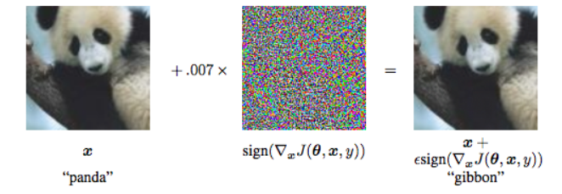

Model Evaluation (the evaluation of deep learning models )
Model Robustness
Robustness is akin to the mathematical concept of stability, which is defined as how effective a model is when tested on a slightly perturbed version of a clean input, where the outcome is supposed to be the same.
Adverserial image
it is possible to add small adversarial perturbations to input data to generate adversarial images which the model misclassifies. This technique of adding adversarial perturbations to input data is known as an adversarial attack.
we make extensive use of adversarial attacks to generate adversarial images for steganalyzers. Current research shows that adversarial images are useful as training samples and help create robust models .

Slide 18
Steganography Techniques
steganographic embedders can be categorized as (1) frequency, (2) spatial, or (3) deep learning:
Frequency :
Frequency domain steganographic embedders use statistical techniques to hide information in the frequency coefficients of an image
Spatial:
Spatial domain steganographic embedders also use statistical techniques but hide information in the raw pixel bits of an image
deep learning
deep learning steganographic embedders use deep learning architectures such as GANs to hide information in an image .
Hint:Deep learning steganographic embedders have been very effective at hiding large quantities of data while avoiding detection from state-of-the-art steganalyzers . it is important to note that every steganographic embedder has a corresponding steganographic decoder that decodes the embedded message from the steganographic image.

Slide 19
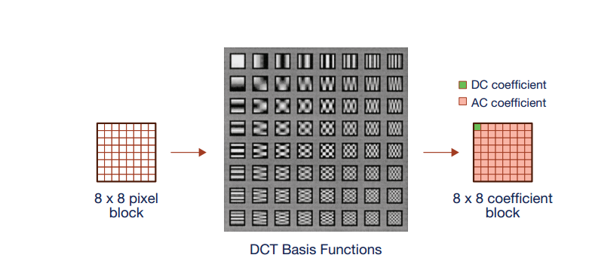
Frquency domain
The frequency domain refers to images represented by signal data, such as the JPEG image format. In this domain, raw image data (pixel values) are translated to signal data via some signal processing method (i.e. discrete cosine transform) to produce a set of signal coefficients (i.e. discrete cosine transform coefficients).

Slide 20
Frquency domain
In the frequency domain, image data is stored in quantized frequency coefficients. Frequency-domain steganography embeds message data by modifying the non-zero frequency coefficients of the image.
While spatial domain steganography operates on pixel values (the left array), frequency domain steganography operates on DCT coefficients (the right array).
Common methods in frequency-based steganography include :
F5
J_UNIWARD
EBS
UED
Hint:For the most part, these methods aim to minimize statistical distortions in the steganographic image.

Slide 21
Frquency domain
The embedding ratio of frequency domain steganography is measured in bits per non-zero AC DCT coefficient (bpnzAC) .The AC coefficients represent 63 total coefficients in each coefficient block, excluding the coefficient at [0, 0] (i.e. 239 ). Traditionally, the coefficient at [0, 0] holds the most signal in that coefficient block and is never modified. Furthermore, zero-valued coefficients are also not counted, since most steganographic embedders avoid using these coefficients.

Slide 22
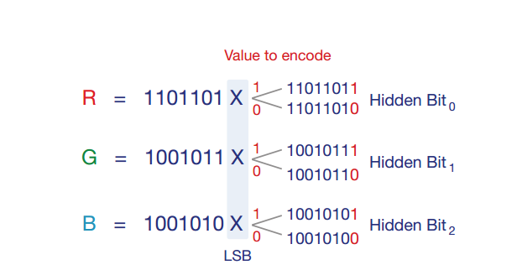
Spatial domain
The spatial domain is defined as the raw image pixels that are used to define an image. For png images, this is the RGB value used to represent each pixel. Spatial domain steganography conceals the secret information within these pixel values, usually by substituting secret bits inside them .
Least significant bit (LSB) steganography is a spatial technique that replaces the last bit of the pixel with message content. For example, if the value being encoded is a 1, the last pixel value bit is set to 1.

Slide 23
Spatial domain
Other methods include:
S UNIWARD
HUGO
WOW
HILL
These methods use sophisticated techniques that minimize image distortion to better embed data, thereby reducing the impact that the embedding operation has on the underlying source distribution of the cover image.

Slide 24
Deep learning domain
The deep learning domain refers to steganographic embedders that make use of deep learning methods to embed steganographic content. steganographic embedders use generative deep learning networks to combine an input message and cover image into a steganographic image.
Different networks used in this approach:
SteganoGAN
HiDDeN
BNet
for example below figure showed the structure of stegano gan, , which makes use of a GAN architecture to generate high-quality steganographic images .

Slide 25
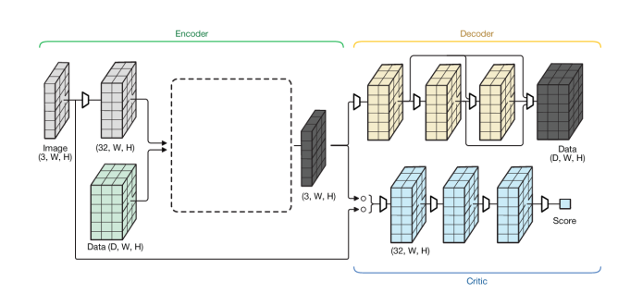
Deep learning domain
Machine learning-based steganography uses machine learning to embed data inside images. This figure shows SteganoGAN, which is a generative adversarial network that embeds messages in a highly undetectable way.

Slide 26
Steganalysis Techniques
Steganalysis is the process that detects whether a file contains steganographic content. Steganalysis procedures fall into one of two categories:
(1) statistical steganalyzers (2) deep learning steganalyzers
statistical steganalyzers :
use extensive feature engineering to exploit the fact that steganographic embedders introduce statistically significant artifacts (i.e. pixel bit values follow unnatural distributions).
deep learning steganalyzers :
use CNN architectures to learn the statistical imprints of different steganographic embedders . These methods have proven to be very effective against spatial and frequency modes of steganography .

Slide 27
Statistical Techniques
Statistical steganalyzers rely on detecting statistical abnormalities introduced via steganographic embedders. For example, LSB steganography has been shown to significantly modify an image’s natural pixel value distribution.
Statistical steganalyzers are often augmented with support-vector machines and specialized feature-engineering to pull out rich signal data from the underlying source distribution , In general, statistical steganalyzers are only effective against a limited set of spatial and frequency-based steganographic embedders .

Slide 28
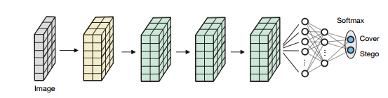
Deep Learning Techniques
Deep learning steganalyzers traditionally use CNN architectures to extract steganographic signal for example following example showed cnn model for steganalyzing.
Other methods in this way are:
YeNet
XuNet
SRNet
CISNet

Slide 29
Challenge in deep learning method
Deep learning steganalyzers depend heavily on their training dataset. even though deep learning steganalyzers have been very effective at steganographic detection, they remain relatively non-robust.
Understanding and solving these failure modes remains one of the more challenging obstacles facing deep learning steganalyzers.

Slide 30
Related works in deep learning
In recent years, the development of deep convolutional neural networks has pushed the boundaries of steganalysis research.
In 2015, Qian et al. published a simple deep learning model that showcased the potential for CNN-based steganalysis .
in 2016, Xu et al. was able to achieve state-ofthe art results using a more complicated network structure.
In 2018, researchers released several new architectures, including Ye-Net ,which used truncated linear activation functions .
Yedroudj-Net [45], which used a small network that could learn with small datasets to reduce computational costs .
SRNet ,which could be adapted to spatial or frequency steganalysis.

Slide 31
Related works in deep learning
most research in the steganalysis domain has focused on :
Developing architectures that boost steganographic signal, since steganalysis operates in a low signal to noise ratio environment.
developing architectures with better convergence guarantees and reduced computational costs .
Recently, researchers have found that many steganalyzers previously considered to be state-of-the-art are particularly non-robust and have a number of failure modes . Specifically, these steganalyzers fail at the source mismatch problem, low embedding ratio problem, and steganographic embedder mismatch problem. They are also prone to adversarial attacks.
Next, researchers have also worked on understanding how to robustly evaluate steganalyzers. Recent work has taken two approaches to tackling the evaluation issue:
formulating standardized methodologies that lead to robust evaluation :
Zeng et al. finds that current steganalyzers are particularly bad at the source mismatch problem and argues that steganalyzers should be evaluated on increasingly diverse source distributions .
Prokhozhev et al. proposes several tactics to improve evaluation methods involving steganographic embedder mismatch problem and the use of large test datasets .
Chaumont et al. finds that researchers should test steganalyzers on more diverse datasets (i.e. image source, image resolution, image format) to evaluate how practical a steganalyzer is.

Slide 32
Related works in deep learning
design and generation of steganographic datasets that allow for evaluation:
When designing these datasets, researchers focus on
(1) cover image sources and (2) steganographic embedder diversity.
The most commonly used evaluation dataset is the BOSS dataset ,which contains gray-scale 512x512 images. More recent work has criticized widespread use of BOSS since it contains limited image diversity .
Another dataset in this issue is:
SIG
StegoAppDB
iStego100k
Notice:these datasets are unchanged and static, their usability diminishes over time and they are rarely adopted by the steganalysis research community.

Slide 33
Universal and Practical Steganalysis(Towards Universal Steganalysis)
Universal steganalysis is defined as a class of steganalyzers that can detect any known or unknown steganographic embedder. We identify the following problems that a universal steganalysis solution must solve:
Source Mismatch Problem - Universal steganalyzers must be able to detect steganographic images regardless of the image source.
Steganographic Embedder Mismatch Problem - Universal steganalyzers must be able to detect steganographic images from any steganographic embedder , including those that they have not been seen before.
Low Embedding Ratio Problem - Universal steganalyzers must be able to detect steganographic images that are embedded with low embedding ratios.
By solving these problems, a steganalyzer would be able to function as a universal steganalyzer in any context.

Slide 34
Towards Practical Steganalysis
Practical steganalyzers must be effective in real-world situations. From a deep learning perspective, this means that models must be efficient and applicable in a diverse set of contexts. Towards this goal, we identify the following problems that a practical steganalysis solution must solve:
Image Size Mismatch Problem - Practical steganalyzers must be able to operate on arbitrary image sizes (i.e. 256x256, 512x512, etc.) so that they can be usefully deployed in an application.
Training and Execution Efficiency Problem - Practical steganalyzers must be able to be trained and updated efficiently so that new training examples can be quickly incorporated into the model. They must also be able to execute efficiently so that they can process a large of number of images quickly.

Slide 35
Dataset Augmentation
data augmentation procedures that generate datasets that can be used to train universal deep learning steganalyzers. Data augmentation is a technique used to artificially expand the training dataset by introducing image modifications that increase the diversity of the dataset. Research in the last few years has shown that data augmentation effectively improves the robustness of deep learning models by providing useful training features.
the following data augmentation procedures that researchers should consider using to augment their steganographic training datasets:
Source diversity
steganographic embedder diversity
embedding ratio diversity

Slide 36
Source Diversity
To solve for the source mismatch problem, we suggest augmenting training datasets with a large sampling of source distributions. We suggest the following data augmentations:
A large variety of camera configurations should be present in the dataset to ensure that that the training dataset contains many source distributions.
A large variety of image sizes and image formats should be present in the dataset to ensure that the training dataset contains a diverse set of source image types.
Standard data augmentation techniques such as random crops, rotations, and translations should be employed to artificially increase source diversity.
By using a diverse set of training images, source distribution signals that confound steganographic signals will be less useful for prediction.

Slide 37
steganographic Embedder Diversity
To solve for the steganographic embedder mismatch problem, we suggest augmenting training datasets with a diverse set of steganographic embedders. We suggest the following data augmentations:
Datasets should skew towards using hard-to-detect steganographic embedders (i.e. SteganoGAN), since they create a more challenging steganalysis problem and provide more useful steganographic signal.
To test universal steganalyzers, the test dataset should be augmented with steganographic embedders that have not been trained on and, preferably, are characteristically different from the training dataset steganographic embedders.

Slide 38
Embedding Ratio Diversity
To solve for the low embedding ratio problem, we suggest augmenting training datasets with a diverse set of embedding ratios. We suggest the following data augmentation:
A large range of embedding ratios should be used for training so that models do not over-fit to a specific embedding ratio. We suggest a range from 0.05 bpp to 1.0 bpp. For deep learning steganographic embedders, researchers should consider increasing the range of embedding ratios present in the training dataset.
Using a wide range of embedding ratios will force models to better learn to detect steganographic signal and prevent overfitting for a specific embedding ratio.

Slide 39
Proposed CNN architectures for steganalysis
we describe two deep learning architectures that provide potential solutions to the challenges facing practical steganalysis.
In pervious sections, we identified that a practical deep learning steganalyzer must be able to solve the following problems: the image size mismatch problem and the training and execution efficiency problem.
To help realize these goals, we use modern CNN methods to design:
ArbNet :
which is compatible with arbitrary input image sizes using a modified DenseNet architecture
FastNet :
which uses a modified EfficientNet architecture to improve computational efficiency.

Slide 40
ArbNet
To solve for the image size mismatch problem, we introduce ArbNet (Arbitrary Image Network), which uses several modifications to the architecture presented in Singh et al. Singh et al. presents a DenseNet structure adapted to fit the steganalysis problem. We use this architecture and modify it in the following ways:
TLU Activation Units. TLU activation units are used instead of ReLU to extract weak steganographic signal.
Modified ConvBlocks. The number of convolutional blocks and specific convolutional layer parameters are modified .
Spatial Pyramid Pooling. Spatial pyramid pooling (SPP), is used instead of global average pooling to boost steganographic signal and enable arbitrary image size detection. SPP produces fixed-length representations at various scales that are invariant to input size.

Slide 41
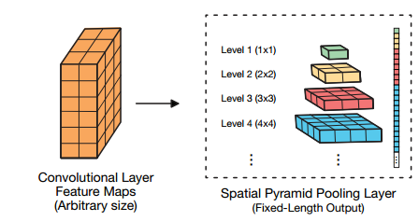
Components of ArbNet
A spatial pyramid pooling (SPP) layer is invariant to input size since it fixes the output size of the pooling layer. Each SPP layer fixes how many sections the input will be divided into for pooling. In this figure, the third layer divides the convolution input into nine pooling sections .

Slide 42
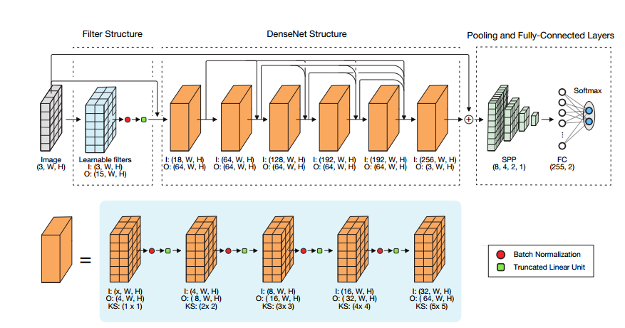
Architecture of ArbNet
ArbNet is a steganalysis CNN model that can be applied to arbitrary image sizes. First, the input image is fed through 15 filters that are initially initialized with 15 SRM HPF’s. Next, the input image and filtered output are fed into a DenseNet structure. Finally, the residual output from the DenseNet is combined with the original image and fed into a spatial pyramid pooling layer, a fully-connected layer, and a softmax function to output the steganographic and cover probabilities.

Slide 43
Conclusion of ArbNet
Each step helps boost weak steganographic signal and makes the model effective in a low signal-to-noise ratio environment. We believe that ArbNet holds a key solution to the image scaling problem as it effectively avoids downsampling input signal while enabling arbitrary image size detection.

Slide 44
FastNet
To solve for the training and execution efficiency problem, we introduce FastNet (Fast Network), which adapts EfficientNets to the steganalysis problem.
EfficientNets are a family of image classification models which achieve state-of-the-art accuracy but are an order of magnitude smaller and faster than previous models , EfficientNets are trained by successively improving older models through a model-scaling process that modifies network depth, width, and resolution.
EfficientNets use MBConv blocks, which can be used for neural architectural search, enabling EfficientNet to use the most effective neural architecture

Slide 45
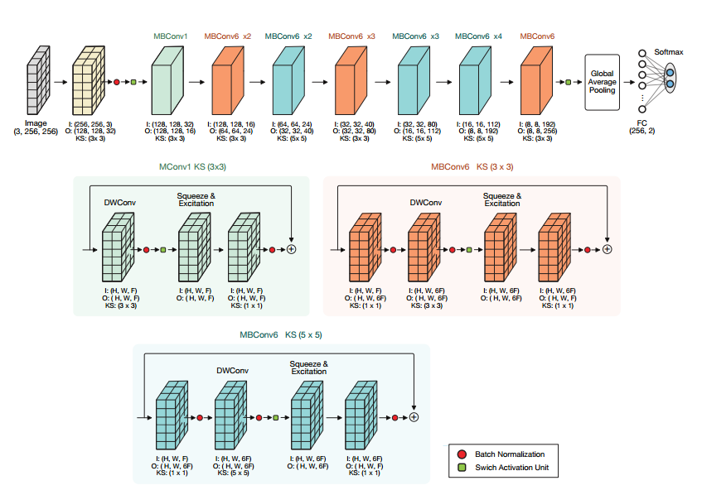
Architecture of FastNet
FastNet uses the EfficientNet-B0 structure and modifies the final few layers to adapt the network to the steganalysis problem. FastNet is composed of MBConv blocks which enable neural architecture search and computational efficiency.

Slide 46
Thanks for your consideration.

